Slide 1

  Real-Time Cloud Intrusion Detection and Automated Threat Response
  Team no. 5
  CSA15 – Cloud computing and Big Data analytics
  Guided By Students Name
  Dr.A.M.Arul Raj ASWATHA V
  Professor SUSHMITHA
  LATISHA
  AMRUTHA
Notes:
1
1

Slide 2
Abstract
Cloud systems face threats like unauthorized access, malware, and data theft.
This project monitors cloud activities to identify suspicious behavior.
Security rules detect potential intrusions and abnormal activities.
Alerts are generated whenever a possible threat is detected.
Automated responses help reduce delays and improve cloud security.

Slide 3
Aim and Objective
Aim
To develop a real-time system that detects cloud intrusions and responds automatically.
Objectives
Monitor cloud activities and user access continuously.
Detect suspicious behavior using security rules.
Identify unauthorized access and abnormal activities.
Generate immediate alerts for potential threats.
Automate suitable security actions and maintain threat logs.

Slide 4
Introduction
Cloud computing provides online storage, applications, and services.
Cloud environments face cyberattacks and unauthorized access.
Intrusion Detection Systems (IDS) identify suspicious activities.
Traditional methods may require manual monitoring and delayed responses.
Automated threat response helps handle security threats quickly.
This project combines monitoring, detection, alerts, and automated actions.

Slide 5
Literature Review
S.No | Year of Publication | Author | Title of the Journal / Book | Methodology Used | Algorithm Used | Key Findings
1 | 2024 | Verify from paper | Machine Learning-Based Cloud Intrusion Detection | Network traffic analysis | Random Forest | Helps classify normal and malicious network activity.
2 | 2024 | Verify from paper | Anomaly Detection in Cloud Environments | Behavioral analysis | Isolation Forest | Identifies unusual activities that may indicate intrusions.
3 | 2024 | Verify from paper | Deep Learning for Network Intrusion Detection | Traffic feature extraction | CNN | Learns patterns associated with malicious traffic.
4 | 2025 | Verify from paper | Intelligent Cloud Security Monitoring | Cloud log analysis | Decision Tree | Supports rule-based classification of suspicious events.
5 | 2025 | Verify from paper | Automated Cyber Threat Detection and Response | Threat detection and response automation | Random Forest | Supports faster threat classification and response workflows.

Slide 6
Problem Statement
Cloud environments face cyberattacks and unauthorized access.
Manual monitoring makes quick threat detection difficult.
Traditional systems may miss new or unusual attacks.
Delayed responses can cause data loss and service interruptions.
An automated system is needed to detect and respond to threats quickly.

Slide 7
Existing System
Traditional systems use predefined rules and known attack signatures.
They mainly identify threats that match existing detection patterns.
Security administrators often need to monitor alerts manually.
Unknown or unusual attacks may remain undetected.
Delayed responses can increase the risk of security damage.
Limited automation makes continuous cloud monitoring more difficult.

Slide 8
Proposed System
Continuously monitors cloud activity and collects security logs.
Analyzes activities using predefined security rules.
Identifies suspicious behavior and potential intrusions.
Generates alerts when security threats are detected.
Stores threat records and displays security information through a dashboard.

Slide 9
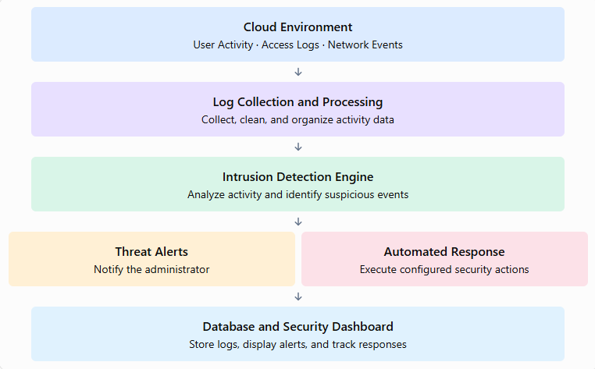
System Architecturel Design

Slide 10


Sustainable Development Goal (SDG) Implementation
SDG 9 – Industry, Innovation and Infrastructure
Supports secure and reliable digital infrastructure.
Encourages innovation in cloud security.
Protects cloud applications from security threats.
Improves the reliability of digital services.
Promotes resilient and sustainable technology systems.

Slide 11
Design & Module Planning
Module 1: Cloud Activity Collection and Processing
Collects cloud activity logs, organizes the data, and prepares it for analysis.
Module 2: Intrusion Detection and Classification
Analyzes activity using security rules to identify normal and suspicious behavior.
Module 3: Automated Threat Response
Triggers predefined security actions and records the response to detected threats.
Module 4: Security Dashboard and Reporting
Displays real-time alerts, threat history, activity records, and response statistics.

Slide 12
Module 1: Cloud Activity Collection and Processing
Collects banking activity logs, including login attempts, fund transfers, data access, and network requests.
Allows users to enter sample activity details through a web interface.
Records user ID, activity type, IP address, date, and time.
Stores all activity records in an SQLite database.
Sends the collected activity data to the intrusion detection module for analysis.

Slide 13
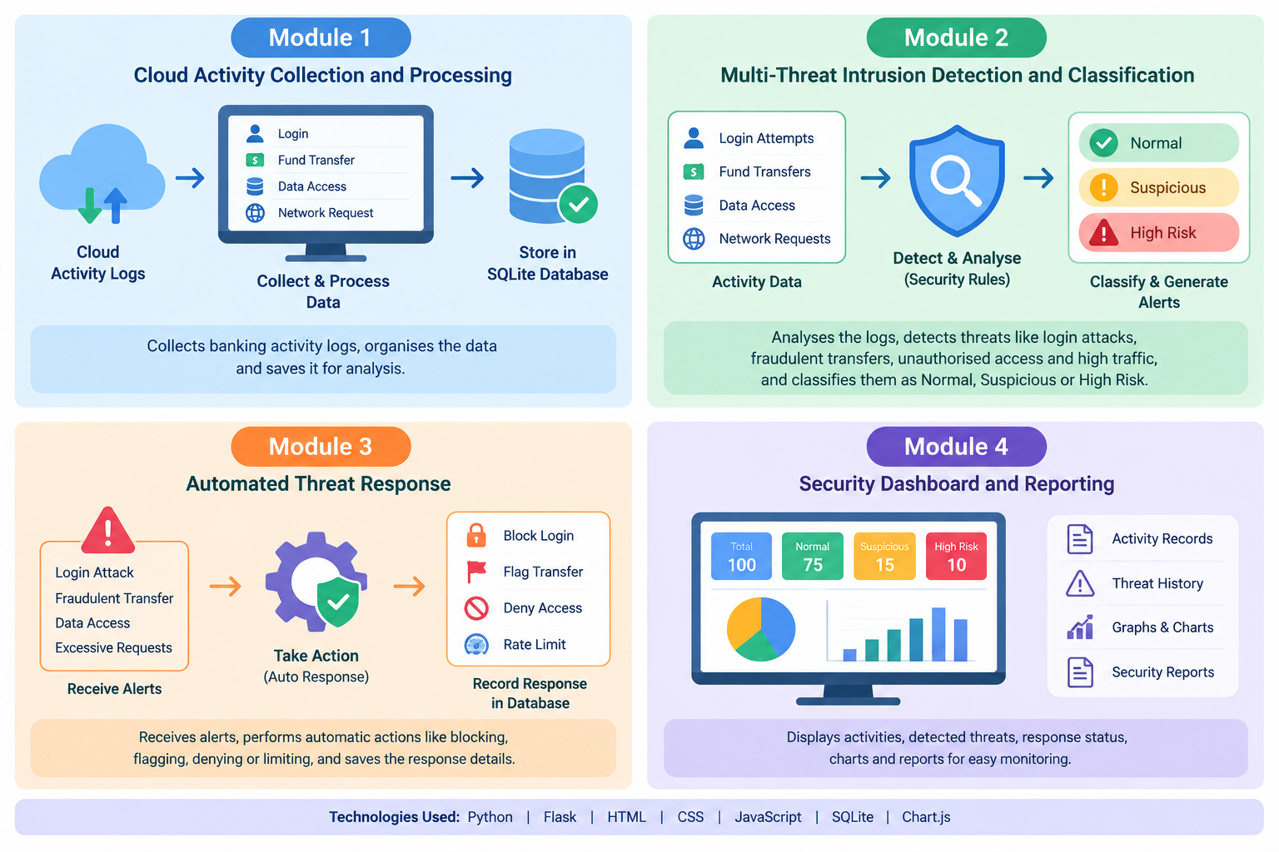
Module 2: Intrusion Detection and Classification
Analyses banking activity logs using predefined Python security rules.
Detects repeated failed logins that may indicate brute-force attacks.
Identifies unusually large fund transfers that may indicate fraud.
Detects unauthorised data access and excessive network requests.
Classifies activities as Normal, Suspicious, or High Risk and generates security alerts.

Slide 14
Module 3: Automated Threat Response
Receives alerts generated by the intrusion detection module.
Simulates temporarily restricting repeated login attempts.
Flags suspicious fund transfers for review and denies unauthorised data access.
Simulates rate limiting when excessive network requests are detected.
Records the response action, threat severity, status, and timestamp in the database.

Slide 15
Module 4: Security Dashboard and Reporting
Displays banking activities and detected threats through a central dashboard.
Shows the total activities, normal activities, suspicious activities, and high-risk threats.
Displays threat categories, severity levels, and automated response status.
Provides tables, charts, and threat history for easy monitoring.
Generates security reports to help identify recurring threats and understand system activity.

Slide 16
Conclusion
The system provides continuous monitoring of cloud activities and security events.
It identifies suspicious behavior and potential intrusions in real time.
Automated responses help reduce delays in handling detected threats.
The dashboard makes security alerts and activity records easier to understand.
The system reduces manual effort and improves security monitoring.
Future improvements can include advanced machine learning and integration with real cloud platforms.

Slide 17
References
Mell, P., and Grance, T. (2011). The NIST Definition of Cloud Computing.
Scarfone, K., and Mell, P. (2007). Guide to Intrusion Detection and Prevention Systems.
NIST. Cybersecurity Framework. https://www.nist.gov/cyberframework
OWASP Foundation. OWASP Top 10. https://owasp.org/www-project-top-ten/
Microsoft Learn. Azure Security Documentation. https://learn.microsoft.com/en-us/azure/security/
NIST. Computer Security Incident Handling Guide. https://csrc.nist.gov/pubs/sp/800/61/r2/final
MITRE. MITRE ATT&CK Framework. https://attack.mitre.org/
Flask Documentation. Flask Web Development Framework. https://flask.palletsprojects.com/

